Slide 1

Flipkart Ecommerce sales data analysis
-Rajeev kumar

Slide 2
About dataset:-
This dataset is about Flipkart ecommerce sales, that was created by extracting data from Flipkart.com, a leading Indian ecommerce website.
This dataset has dimension of (20000, 15).
This dataset has following columns:-
product_url, product_name, product_category_tree,
paid,retail_price, discounted_price, image, is_FK_Advantage_product,
description, product_rating,overall_rating, brand, product_specifications.
There is about 5864 missing value found in brand column.
There is no any duplicate values found in dataset.

Slide 3
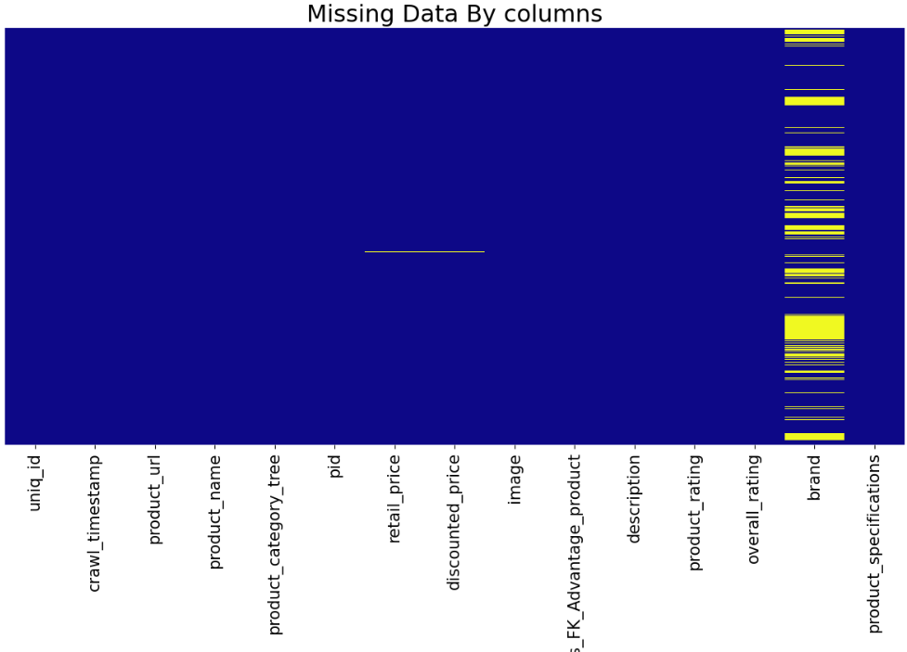
Missing values by columns in Dataset:-

Slide 4
Objectives:-
What is the structure of the dataset? Are there any missing entries, duplicate records, or NaN values?
Does the data require preprocessing? Should we adjust date and time formats or improve the categorization?
During which months or years do we observe the highest sales figures?
Which product categories generate the largest volume of sales?
Which categories offer the highest discount percentages?

Slide 5
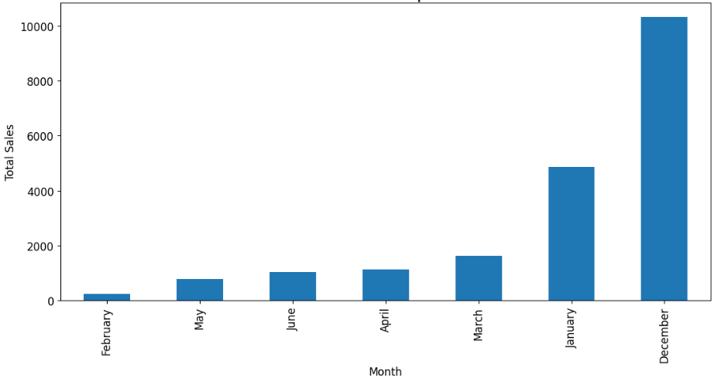
total sales per month:-
January - 4850
February - 245
March - 1634
April - 1137
May - 773
June - 1046
December - 10315

Slide 6
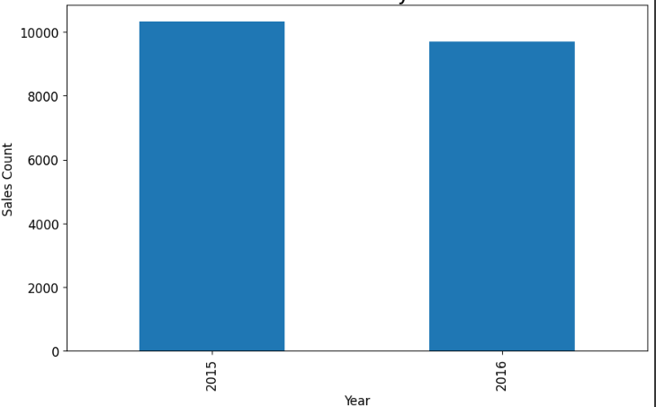
Total Sales by year:-
2015 - 10315
2016 - 9685

Slide 7
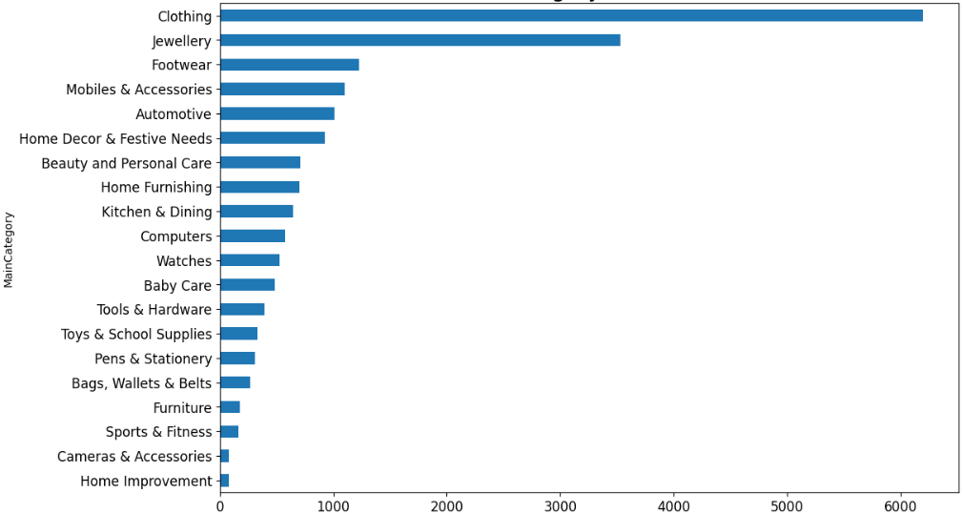
Top 10 Main category sales distribution :-
Clothing - 6198
Jewellery - 3531
Footwear - 1227
Mobiles & Accessories - 1099
Automotive - 1012
Home Decor & Festive Needs - 929
Beauty and Personal Care - 710
Home Furnishing - 700
Kitchen & Dining - 647
Computers - 578
The primary category are Clothing, Jewelry, Shoes, Electronics, and Automotive!

Slide 8
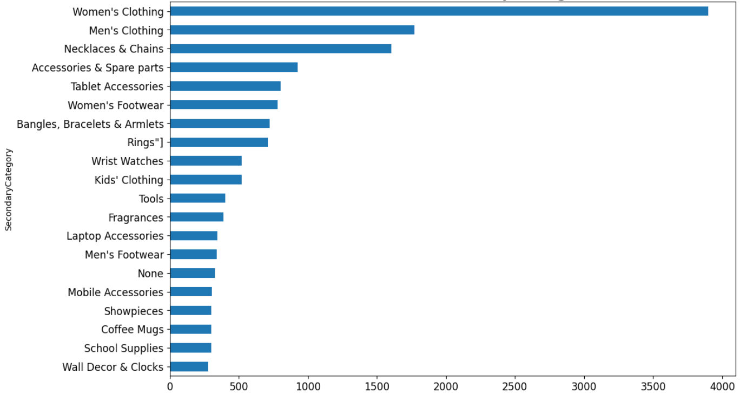
Top 10 secondary categories sales distribution:-
Women's Clothing - 3901
Men's Clothing - 1773
Necklaces & Chains - 1606
Accessories & Spare parts - 925
Tablet Accessories - 801
Women's Footwear - 781
Bangles, Bracelets & Armlets - 724
Rings - 710
Wrist Watches - 523
Kids' Clothing - 520
Women's clothing sales exceed those of Men's clothing by more than two fold. This indicates a significant female user base on Flipkart, despite the absence of a gender column.

Slide 9
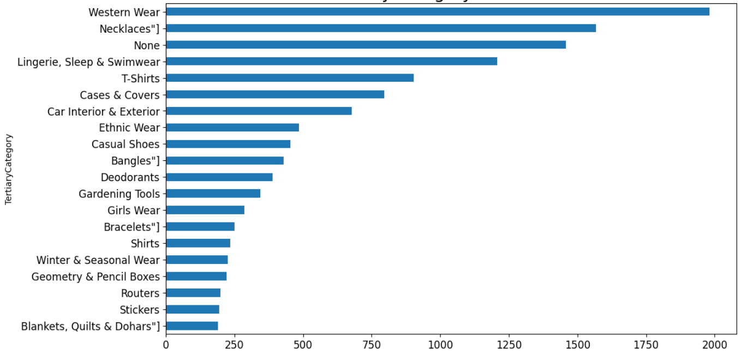
Top 10 Tertiary categories sales distribution:-
Western Wear - 1981
Necklaces - 1567
None - 1457
Lingerie, Sleep & Swimwear - 1208
T-Shirts - 903
Cases & Covers - 796
Car Interior & Exterior - 677
Ethnic Wear - 485
Casual Shoes - 454
Bangles - 430

Slide 10
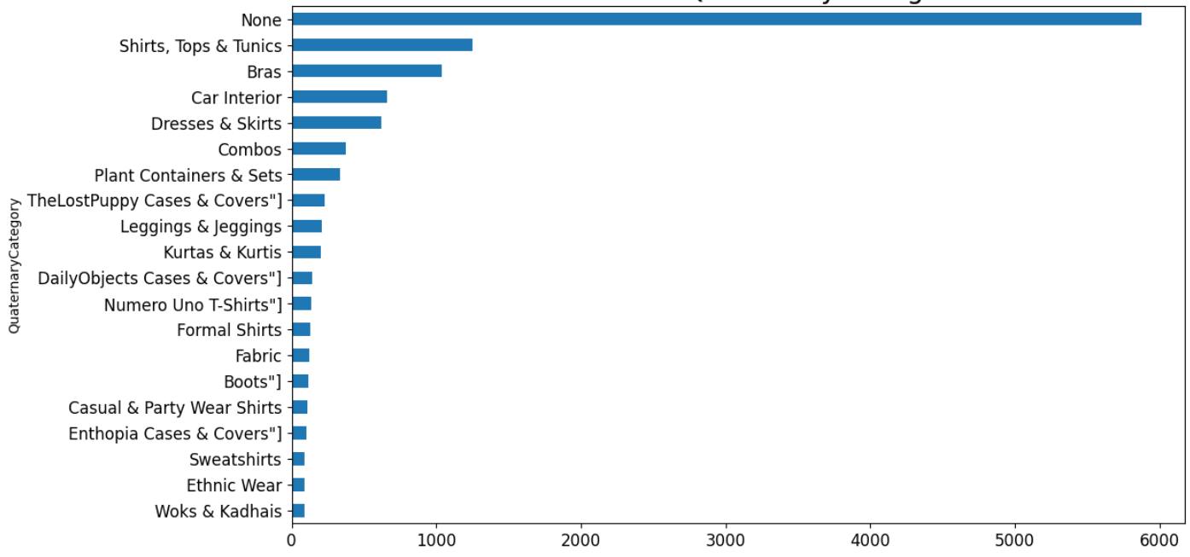
Top 10 Tertiary categories sales distribution:-
None - 5876 (missing data)
Shirts, Tops & Tunics - 1249
Bras - 1036
Car Interior - 659
Dresses & Skirts - 620
Combos - 375
Plant Containers & Sets - 333
TheLostPuppy Cases & Covers - 229
Leggings & Jeggings - 209
Kurtas & Kurtis - 202

Slide 11
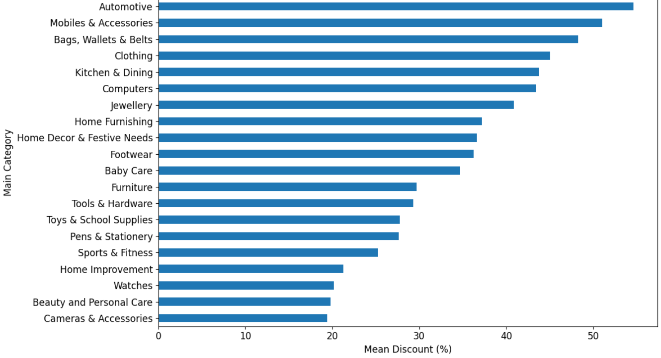
Main category by discount percentage:-
Automotive, clothing, and electronics were among the categories with the highest discounts.

Slide 12
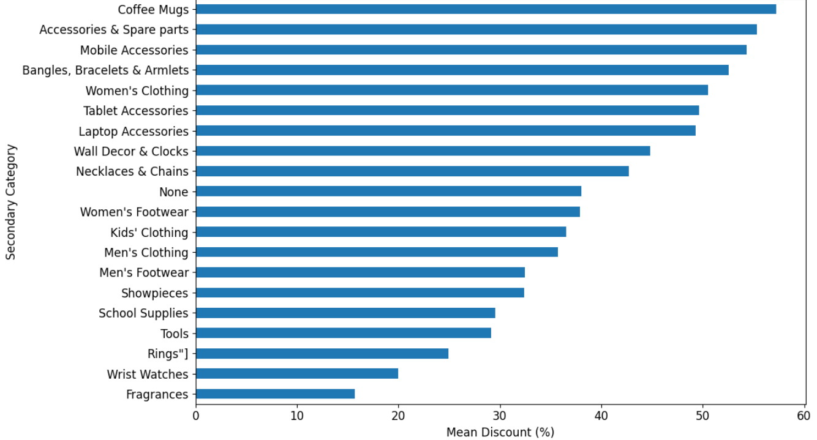
Secondary category by discount percentage:-
For the secondary category, electronics and accessories appeared again, along with some clothing, spare parts, and jewelry. Interestingly, coffee mugs were absent from the list

Slide 13
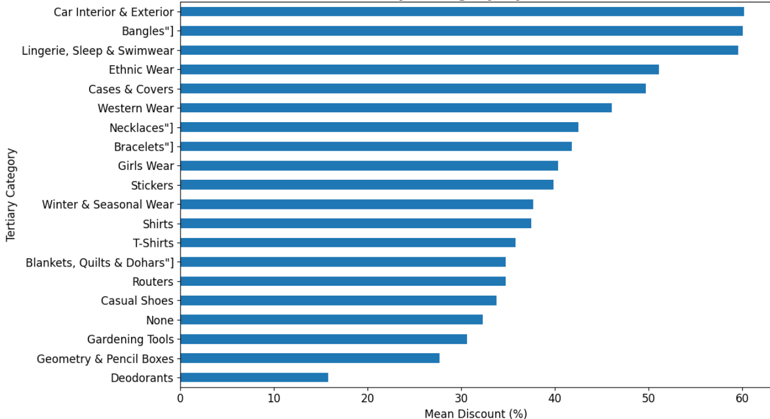
tertiary category by discount percentage:-
Automotive parts on top again, followed by mostly jewellery and clothing. None is present

Slide 14
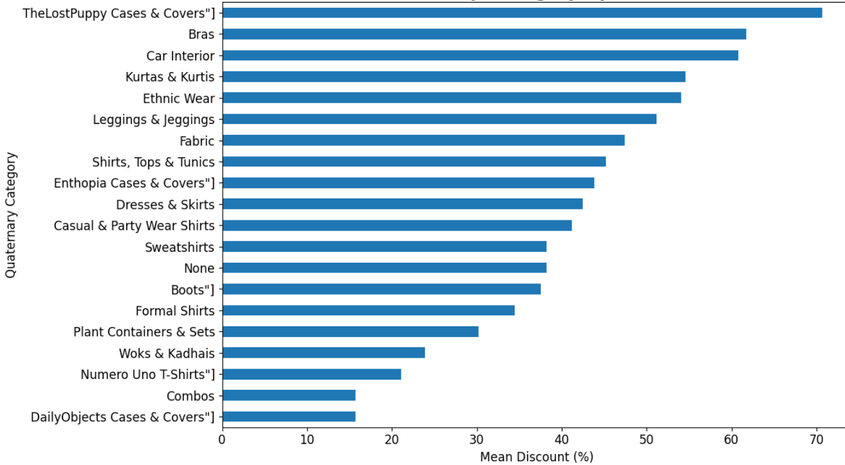
Quaternary category by discount percentage:-
The Quaternary category is dominated by mostly clothing, with come automotive and electric categories.

Slide 15
Conclusion:-
Does the following analysis satisfy any of the objectives??
The data required conversion for proper datetime processing, and additional, more descriptive subcategories were generated to improve clarity and organization.
The dataset appears to be nearly complete, with minimal missing information and no duplicate records.
The months section lacked nearly half a year’s data, with no sales recorded between July and November. Additionally, the Year category only covered two years, both of which showed similar trends.
The categories that generated the highest sales included women's clothing, electronics, jewelry, and automotive products.
The highest discounts were found in the automotive, electronics, accessories, and clothing categories.

